Slide 1


Downside Risk
Georgio Najm
and
Tevin Parathattal
October 6, 2025

Slide 2
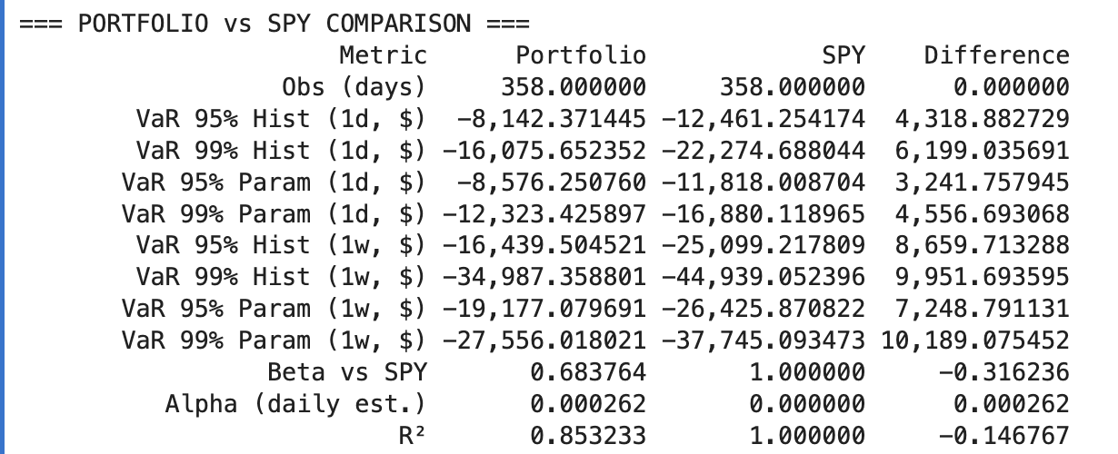
SPY vs SMIF Value at Risk

Slide 3
Why Downside Risk Matters?
Core question: Do investors really care about all volatility or just losses?
Why it matters: Standard deviation and Sharpe ratio treat upside and downside the same, but upside volatility does not hurt.
Today’s agenda:
Downside Beta, Semi-Deviation, Sortino Ratio
Value at Risk (VaR) and Conditional VaR (Expected Shortfall)
Goal for SMIF: Build a risk framework that highlights true risks to the portfolio rather than noise from positive volatility
Notes:
Investors don’t fear all volatility — only losses.
Upside volatility doesn’t hurt; downside volatility does.
Downside risk isolates the part of volatility that actually matters.
Our goal for SMIF: highlight true portfolio risk, not noise from positive swings.

Slide 4
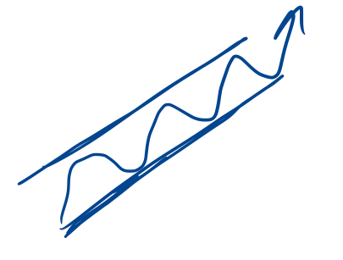
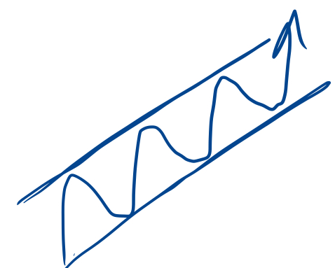
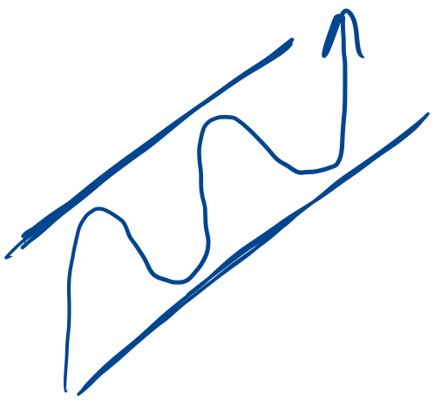
Downside Beta (𝜷 ⁻)
Definition: Sensitivity of a stock/portfolio to the market only when the market is down
Regular Beta: all market movements
Downside Beta: focuses on only losses
Used to understand how exposed an asset is in bear markets or downturns
(β‾) = 0.8
(β‾) = 1
(β‾) = 1.4
Less Volatile
Relative to market (S&P 500)
More volatile

Slide 5
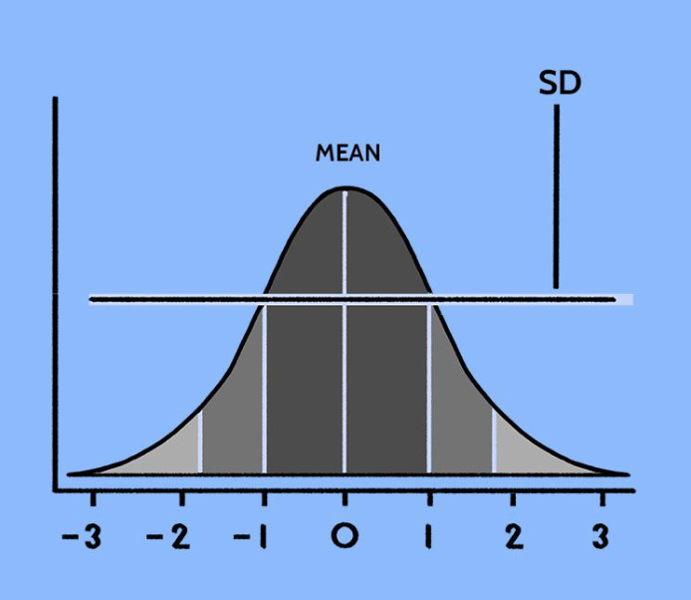
Standard Deviation vs Semi-Deviation
Standard deviation treats all volatility equally, good or bad.
Semi-deviation isolates performance below the mean or target (bad volatility)
Highlights the volatility investors actually care about – losses
Semi-deviation forms a basis for a more realistic risk measure like the Sortino Ratio

Slide 6
Sortino Ratio – Reward for Downside Risk
SR = ⎯⎯⎯
R_{p} - r_{f}
Semi-σ
R_{P}= Actual or expected portfolio return
r_{f} = Risk-Free Rate
Semi-σ = semi-deviation (measures losses only)
Measures return earned per unit of downside risk
Unlike Sharpe, ignores upside volatility
Notes:
Measures return earned per unit of downside risk.
Higher Sortino = more efficient downside performance.
Focuses on quality of risk-taking, not just stability.

Slide 7
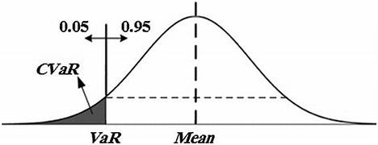
Conditional Value at Risk (CVaR)
Aka Expected Shortfall – measures are average loss beyond the VaR cutoff
Example:
95% VaR (-$8k)= “We’re 95% confident we won’t lose more than this
CVaR = (-$12k) = “But if we do fall into that worst 5%, here is the average damage
Takeaway: VaR shows the edge, CVaR shows how far we fall once past it

Slide 8
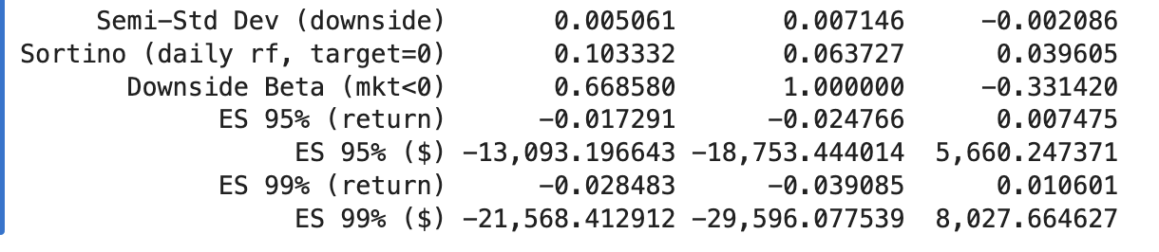
SMIF Portfolio Risk Metrics - Semi-Std Dev, Sortino, Downside Beta, Expected Shortfall

Slide 9
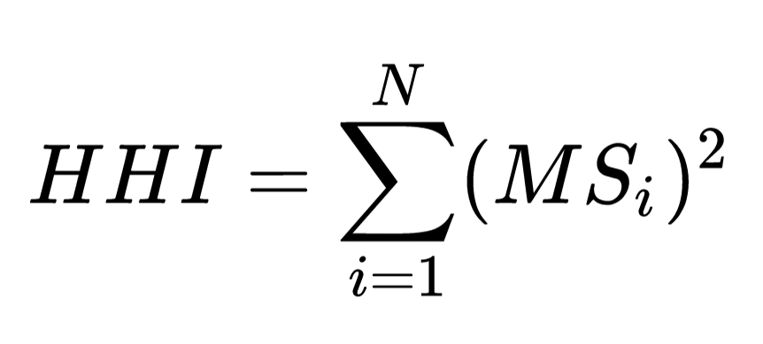
Diversification Metric - Herfindahl–Hirschman Index
Measures concentration of portfolio or market exposure.
Range: 0–1 → lower = more diversified, higher = more concentrated.
Interpreting the Number:
0.25 → concentrated
0.05–0.25 → moderate
<0.05 → well diversified
Effective N = 1/HHI → number of “equal-weight” holdings.
Used to gauge diversification risk or market dominance.
Notes:
MS is market share
Value of portfolio/total portfolio value

Slide 10
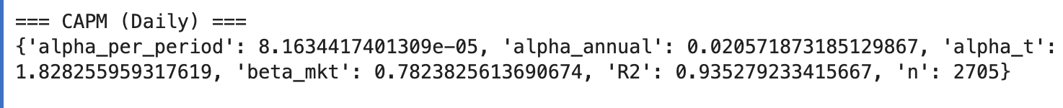
CAPM Alpha
Alpha ≈ +2.1% annualized → Slight positive excess return after adjusting for market risk
Beta ≈ 0.78 → Below-market volatility; portfolio moves less than the market
R² ≈ 0.94 → Very high market correlation; returns are mostly explained by market movements

Slide 11
Quick Introduction to the Fama-French Models
Fama–French 3-Factor (FF3)
Market (MKT-RF): The excess return of the market over risk-free.
Size (SMB = Small Minus Big): Small-cap stocks outperform large-caps, on average.
Value (HML = High Minus Low): Value stocks (high book-to-market) outperform growth stocks.
Fama–French 5-Factor (FF5)
Profitability (RMW = Robust Minus Weak): Profitable firms outperform weak ones.
Investment (CMA = Conservative Minus Aggressive): Firms that invest conservatively outperform heavy-investment firms.
If we control for common knowledge, how good are you?
Notes:
3-Factor Model: • Market (MKT–RF) — overall market risk. • Size (SMB) — small vs. large-cap performance. • Value (HML) — value vs. growth tilt.
5-Factor Model: adds • Profitability (RMW) — strong vs. weak firms. • Investment (CMA) — conservative vs. aggressive investors.
Helps us see whether returns are from skill or exposure to common factors.

Slide 12
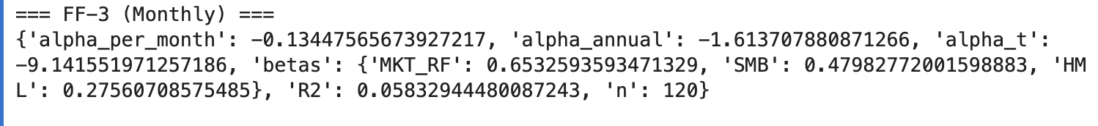
Fama-French 3 Factor Model
Alpha ≈ –1.6% annualized → Underperforms once size/value factors are controlled
MKT–RF beta ≈ 0.65 → Still strongly tied to the overall market
SMB beta ≈ +0.48 → Tilted toward small-cap/growth exposure
HML beta ≈ –0.27 → Tilted away from value (favoring growth stocks)
R² ≈ 0.65 → Lower variance explained than CAPM → factor tilts matter more than market exposure
Interpretation: Once size and value factors are included, “alpha” effectively disappears → performance reflects style exposure (growth/small-cap tilt) rather than stock-picking skill

Slide 13
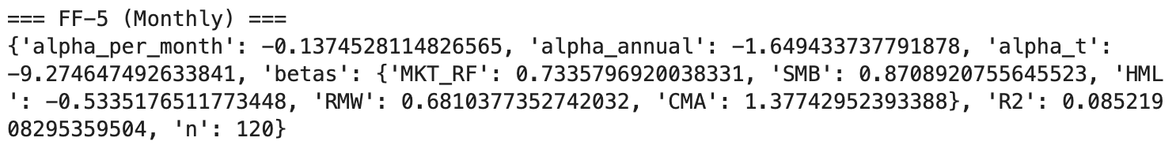
Fama-French 5 Factor Model
Alpha ≈ –5% annualized → Underperforms once size, value, profitability, and investment tilts are controlled
MKT–RF β ≈ 0.73 → Still highly correlated with the overall market
SMB β ≈ +0.41 → Tilt toward smaller-cap stocks
HML β ≈ –0.90 → Strong growth bias (anti-value tilt)
RMW β ≈ –0.21 → Low-profitability exposure
CMA β ≈ +0.20 → Slightly conservative investment tilt
R² ≈ 0.65 → Most returns explained by common factors, not active stock-picking skill

Slide 14
Q-Factor Model
Developed by Hou, Xue, and Zhang (2015) as an alternative to Fama-French
Grounded in investment-based asset pricing theory rather than pure empirical anomalies
Four factors:
Market (broad market excess return)
Size (small minus big)
Investment (conservative vs. aggressive firm investment)
Profitability (robust vs. weak operating profitability)
Interprets anomalies as outcomes of firm decisions on investment and profitability
Claims greater parsimony and theoretical foundation than Fama-French
Alpha represents true stock-picking skill after controlling for these economic drivers
Notes:
Companies make choices: how much they invest, how much profit they generate.
Those choices affect their stock returns in predictable ways.
The Q-factor model says:
Stocks move with the market.
Small companies behave differently from big ones (size).
Companies that invest cautiously (don’t blow cash on projects) do better than aggressive spenders (investment).
Companies that make strong profits beat weak ones (profitability).
If you’re making money just by holding profitable, conservative firms, that’s not skill—that’s just loading on these factors.
Alpha here = did you earn money that can’t be explained by market, size, investment, or profitability?
👉 Think of it like stripping excuses away:
CAPM says: “You only beat the market if you dodge beta.”
Fama-French says: “Nope, also no extra points for picking small or cheap stocks.”
Q-Factor says: “And don’t act like buying profitable or conservative-investment firms is skill either.”

Slide 15
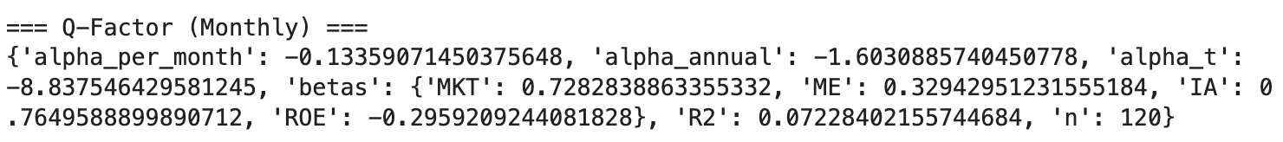
Q-Factor Model
Alpha ≈ –1.6% annualized → Underperforms after controlling for investment and profitability factors
MKT β ≈ 0.73 → Still tied to the overall market
ME β ≈ +0.33 → Slight small-cap tilt
IA β ≈ +0.76 → Strong tilt toward firms with high investment activity (i.e., aggressive reinvestors)
ROE β ≈ –0.30 → Tilt away from high-profitability firms (leaning toward low-ROE/growth names)
R² ≈ 0.07 → Very low explanatory power → returns largely driven by idiosyncratic or style-specific factors
Interpretation:
Once Q-factor controls (market, size, investment, profitability) are applied, alpha turns negative — indicating performance is not explained by skill but by exposure to low-profitability, high-investment growth stocks.
Notes:
Companies make choices: how much they invest, how much profit they generate.
Those choices affect their stock returns in predictable ways.
The Q-factor model says:
Stocks move with the market.
Small companies behave differently from big ones (size).
Companies that invest cautiously (don’t blow cash on projects) do better than aggressive spenders (investment).
Companies that make strong profits beat weak ones (profitability).
If you’re making money just by holding profitable, conservative firms, that’s not skill—that’s just loading on these factors.
Alpha here = did you earn money that can’t be explained by market, size, investment, or profitability?
👉 Think of it like stripping excuses away:
CAPM says: “You only beat the market if you dodge beta.”
Fama-French says: “Nope, also no extra points for picking small or cheap stocks.”
Q-Factor says: “And don’t act like buying profitable or conservative-investment firms is skill either.”

Slide 16
QUESTIONS?

